Slide 1


HUM 102 Report Writing Skills
Lecture 02

Slide 2
Previous Lecture
Basics of a report
Report characteristics
Expectation and purpose
Significance of a report
Relevance, attributes and features of a report
Comparison of a report and essay

Slide 3

Audience
Technical
Readers
Managerial
Readers
General
Readers

Slide 4

Purpose
Information
Instruction
Description
Explanation
Mechanism

Slide 5
Examples
Technical Report
Instruction
Description
Résumé
Memorandum
Press Releases
E-mails

Slide 6
Technical Report Writing
Written account of events related to a scientific inquiry
An exercise of effectively communicating a technical information
Interpretation of graphs, tables and figures using language
Foundation: organization of information

Slide 7

Universal Characteristics
Active Voice
Third Person
No Personal Pronouns for Objectivity
One Inch Margin on all Sides
Proper Citation
Referencing Credible Authors

Slide 8
Report Structure: Title Page
Title
Submission Date
From
To

Slide 9
Report Structure: Abstract
Qualitative
Purpose and outcome with results
No abbreviations

Slide 10

Report Structure: Table of Contents
Section
Appendices
Subsection

Slide 11
Report Structure: Introduction
Problem Description
Objectives
Methods
Most Interesting Results
Brevity

Slide 12

Report Structure: Design and Procedure
Theoretical Description of Design
Testing of Proposed Design
No Specific Measurements
Brief and Getting to the Point

Slide 13

Report Structure: Results and Discussions
Textual explanation accompanied with:
Figures
Tables
Diagrams

Slide 14
Report Structure: Conclusion
Quantitatively Summing Up all the Results with Brevity
No Abbreviations
Problems
Objectives
Procedures
Results

Slide 15
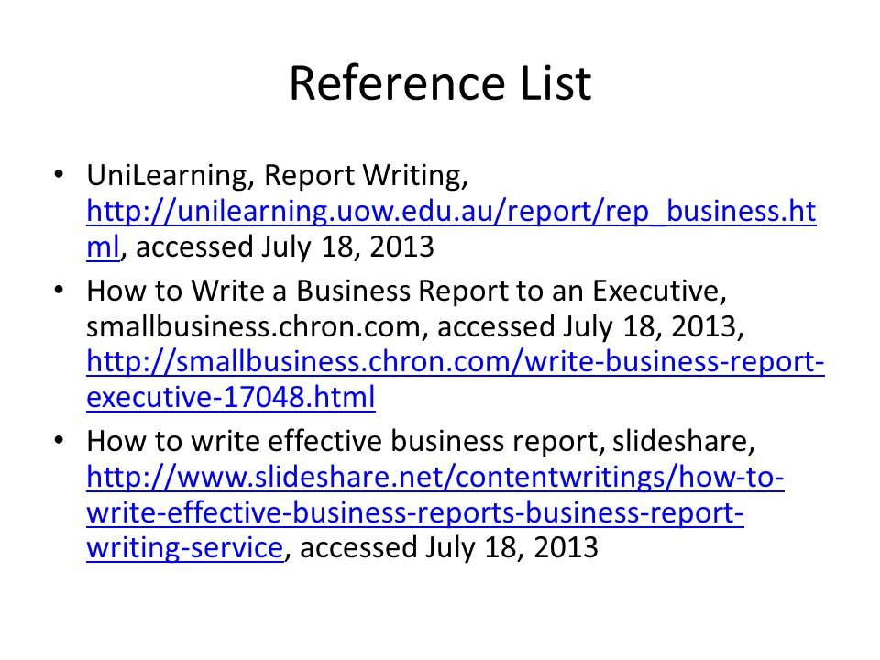
Report Structure: Works Cited and Appendix

Slide 16

Report Structure: Nature of Readers
Technical Readers
Figures
Executive Summary
General Readers
Comprehensible Language
Managerial Readers

Slide 17

Report Structure: Language
Clarity
active verbs
declarative and simple sentence
Objectivity
no use of ‘I’ or ‘we’
Brevity

Slide 18

Deductive vs. Inductive Report
Deductive Report Inductive Report
Routine messages
Neutral information
Open and clear presentation of information
Discussion before conclusion
Use of factual information to draw conclusion
Used in the case of informed readers
With the expected resistance

Slide 19

Deductive vs. Inductive Report
Deductive Report Inductive Report

Slide 20
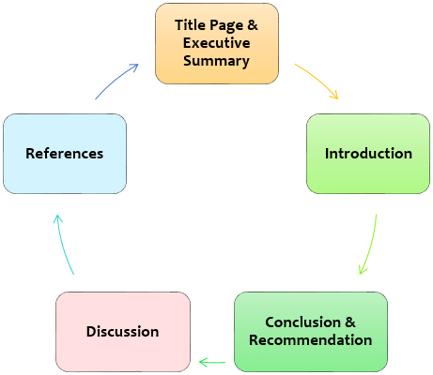
Deductive vs. Inductive Report
Deductive Report Inductive Report

Slide 21
Deductive vs. Inductive Report
Deductive Report Inductive Report

Slide 22
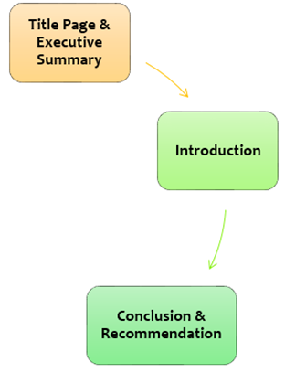
Deductive vs. Inductive Report
Deductive Report Inductive Report

Slide 23

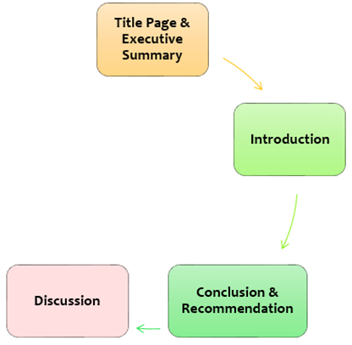
Deductive vs. Inductive Report
Deductive Report Inductive Report

Slide 24
Deductive vs. Inductive Report
Deductive Report Inductive Report

Slide 25

Deductive vs. Inductive Report
Deductive Report Inductive Report
Specific General

Slide 26

Deductive vs. Inductive Report
Deductive Report Inductive Report

Slide 27
Deductive vs. Inductive Report
Deductive Report Inductive Report

Slide 28
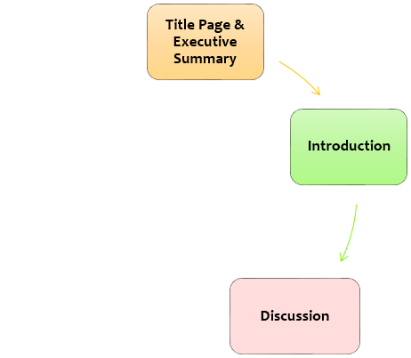
Deductive vs. Inductive Report
Deductive Report Inductive Report

Slide 29
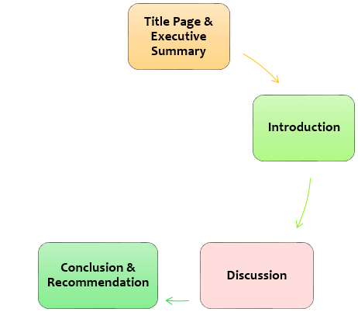
Deductive vs. Inductive Report
Deductive Report Inductive Report
General Specific

Slide 30
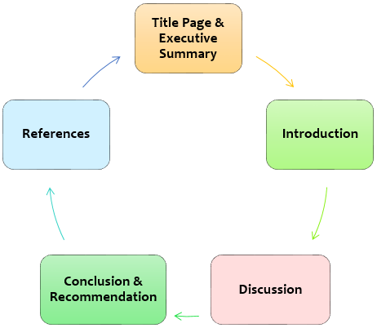
Deductive vs. Inductive Report
Deductive Report Inductive Report

Slide 31
Deductive vs. Inductive Report
Deductive Report Inductive Report
Specific General
General Specific

Slide 32
Conclusions
Technical communication
Nature of the audience
Structure of a report
Deductive vs. Inductive report

